Slide 1
Smart Bill
SUBMITTED BY:-
Jitendra Kumar Yadav(2210991720)
Manasvi(2210991876)
SUBMITTED
TO
Dr. Suhasini

Slide 2
INTRODUCTION
The Electricity Bill Management System is designed to simplify the management of electricity bills for users.
This system provides a platform where users can easily register, log in, and manage their billing information.
By leveraging modern technologies, we aim to enhance user experience and streamline the billing process.
The project is developed using Java for the backend and MySQL for database management.
Our goal is to create a reliable and efficient system that meets user needs and expectations.

Slide 3
Project Objectives
The primary objective of this project is to provide a user-friendly interface for managing electricity bills.
We aim to enable secure user signup and login processes to protect user data.
Additionally, the system will allow users to view, edit, and manage their billing information seamlessly.
We also plan to implement features that will notify users of upcoming due dates and payment confirmations.
Ultimately, our goal is to improve the overall efficiency of electricity bill management for users.

Slide 4
Progress Overview
As of now, we have made significant progress in the development of the system.
The user register process has been successfully completed, allowing new users to register
Previous user can also login by using correct userid and password which is then verified with databse.
We have also developed the home page for authenticated users, which displays relevant billing information.
Database integration has been established, enabling secure storage and retrieval of user data.
Overall, we are on track to meet our project milestones and deadlines.

Slide 5
Register Process
The signup process is a crucial component of our system, designed for ease of use and security.
Users are required to input their name, email, and a secure password during registration.
We have implemented validation checks to ensure that the email format is correct and that passwords meet strength requirements.
Upon successful registration, a new user record is created in the database, ensuring data integrity.
Error handling mechanisms are in place to provide user-friendly messages for issues like duplicate accounts or invalid inputs.

Slide 6
Register Types
While registering there are two types of account that can be opened via register :-
1. As ADMIN - In this type of register account , the person gets admin right i.e. he/she can change,add,update,delete the biling information by using his/her rights
2. As Customer - In this type of account , a person can see,fill his/her biling information and even pay his/her billing amount and be even remain updated.

Slide 7
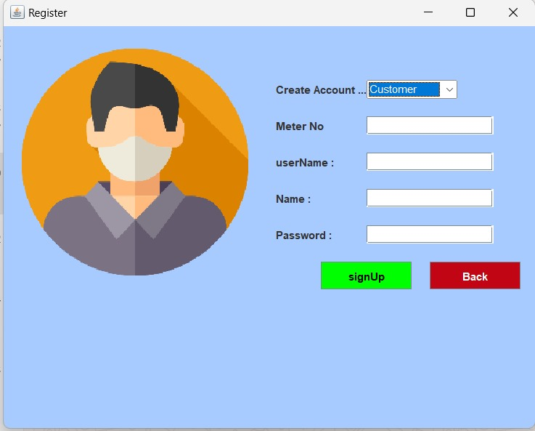

Register Account UI
CUSTOMER account
ADMIN account

Slide 8
Login Process
The login page is a critical component of the Electricity Bill Management System, providing users with secure access to their accounts.
Key features of the login page include:
User Input Fields
Validation Checks
Security Measures
SignUp Button
Login Button
Overall, the login page is designed to be intuitive, secure, and efficient, ensuring a smooth user experience while maintaining data protection.

Slide 9
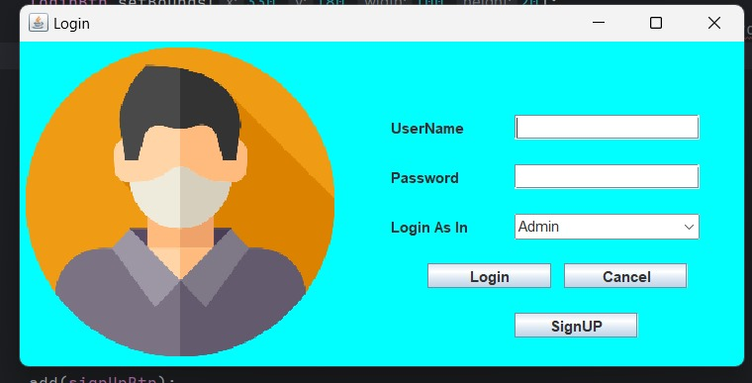
Login Page

Slide 10
HOME Page
Home page consists of :-
1.Menu Button - To check various more buttons
2.Information Button - To check information of the bill
3.User Button - To verify username / information about user
4.Bill Button - to check bill
5.Utility Button -
6.Exit button - to exit the app

Slide 11
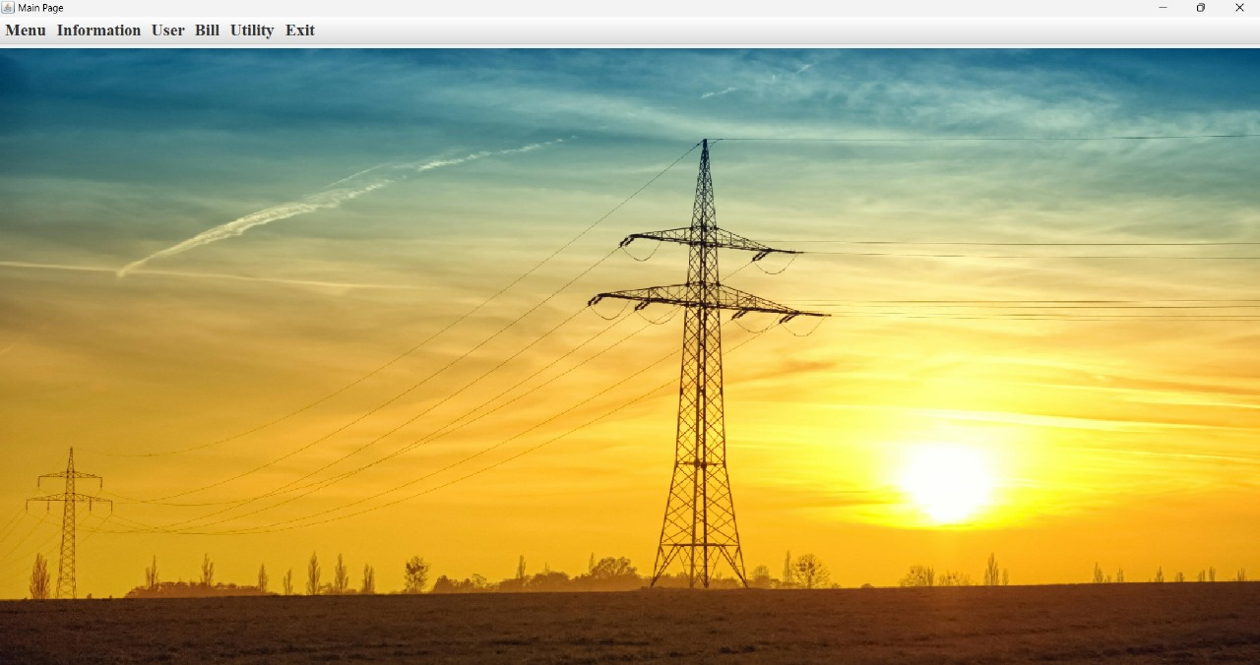
HOME Page

Slide 12
Tech Stack
ForntEnd – Java Swing
Backend – Java
DataBase – My Sql

